Slide 1
Team 18 - Part 2
Mechanical Design and Transmission Components

Slide 2
Team 18 Members:
Md
Sepehr Rezvanifard
Harsimranjeet
Karamvir
Proposed Vehicle:
Light and quick electric vehicle
Single Passenger
Intended for short trips in the city
Low Maintenance
High Safety considerations

Slide 3
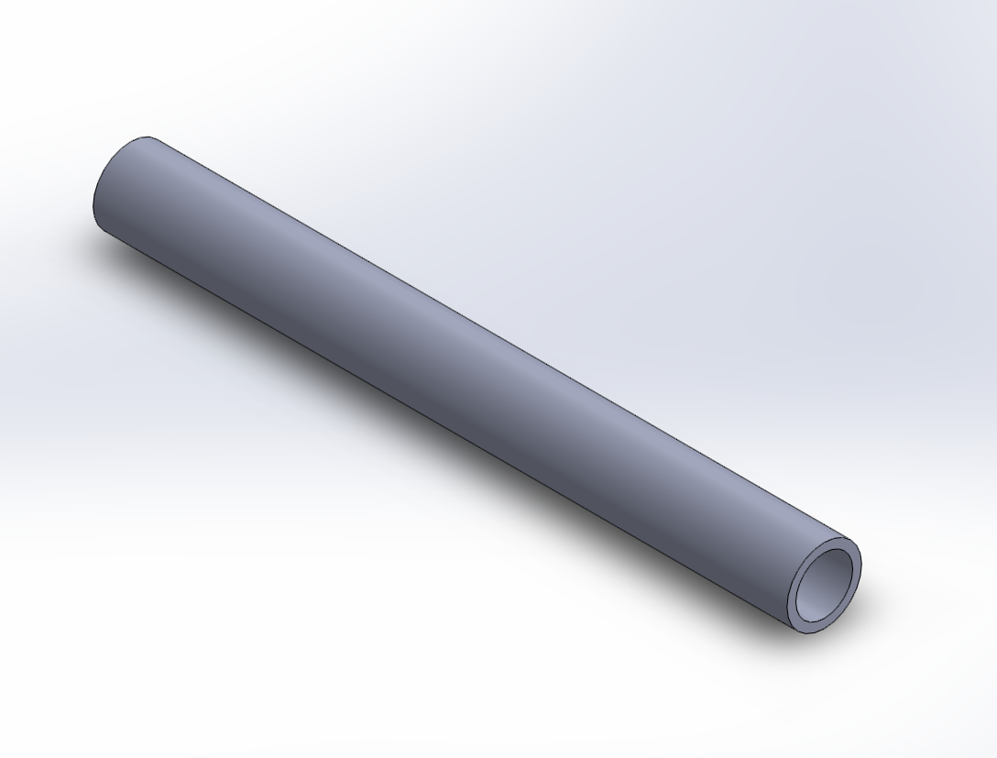
Chassis:
Tadpole Configuration -More stable than delta for 3 wheel vehicles
Space Frame Design
-Constrained trusses that withstand bending stress
Chassis Structural Members:
-Pipe Cross Section
-ISO Standard
-(26.9 x 3.2)mm
-SAE 1060 Plain Carbon Steel

Slide 4
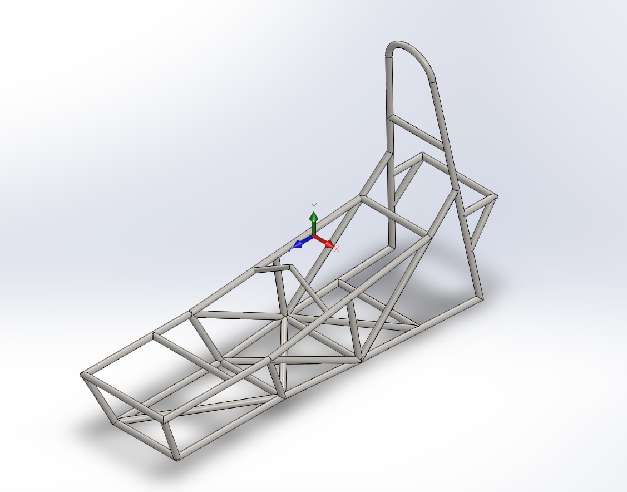

Slide 5
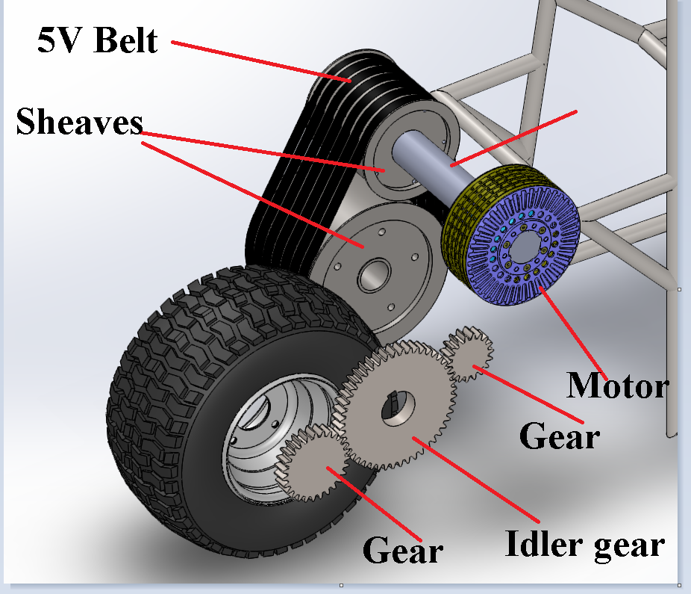
Drive Train High Level
Emrax 208 Electric AC Synchronous Motor
Motor RPM - 3000RPM
Motor Torque - 163Nm (120ftlb)
Wheel Diameter - 15”
Wheel RPM(Max) - 1344
Max Speed - 60mph

Slide 6
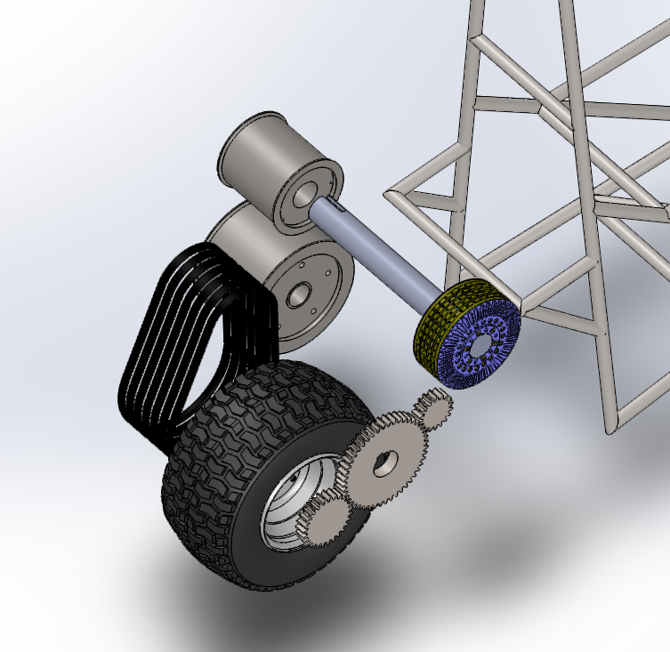
Drivetrain Exploded View

Slide 7
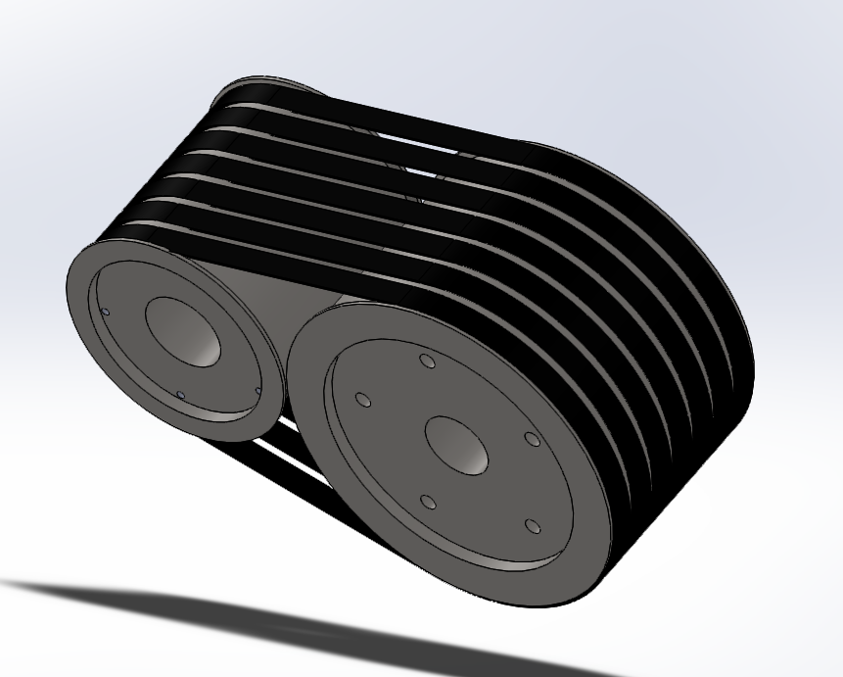
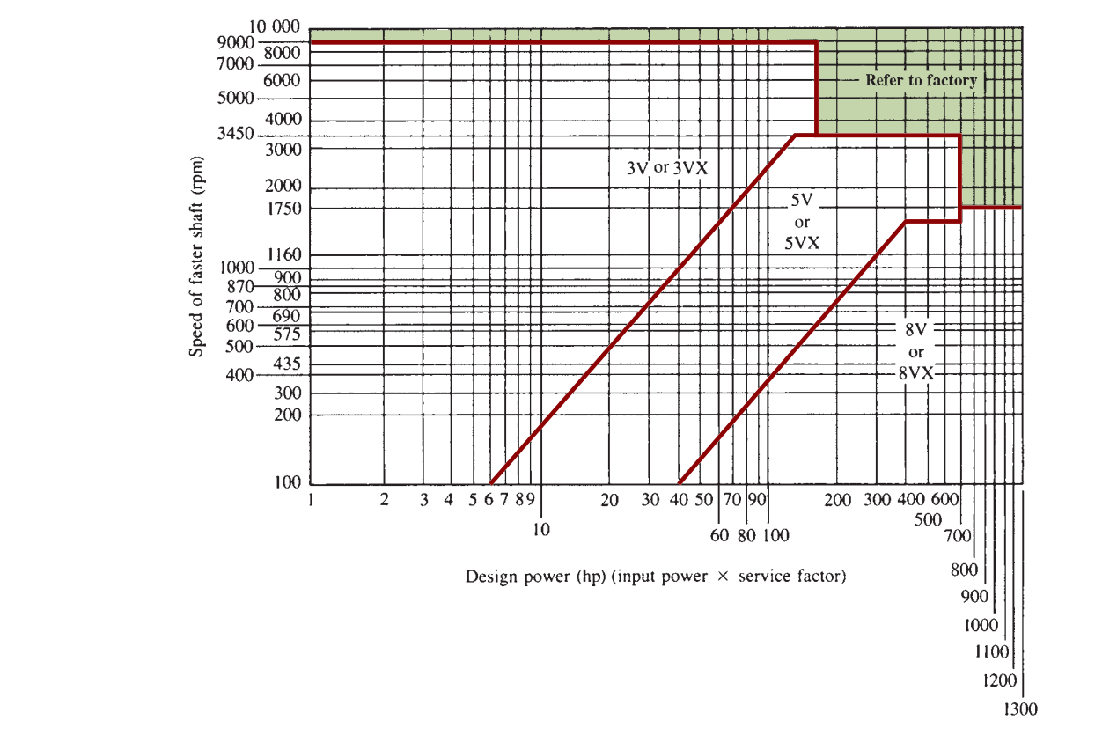
Belt Drive System
Specifications:
-Baldor 5V Belts -Output RPM (Driving Belt): 2280RPm
-Diameter (Sheaves) - 7.10” and 10.9”

Slide 8
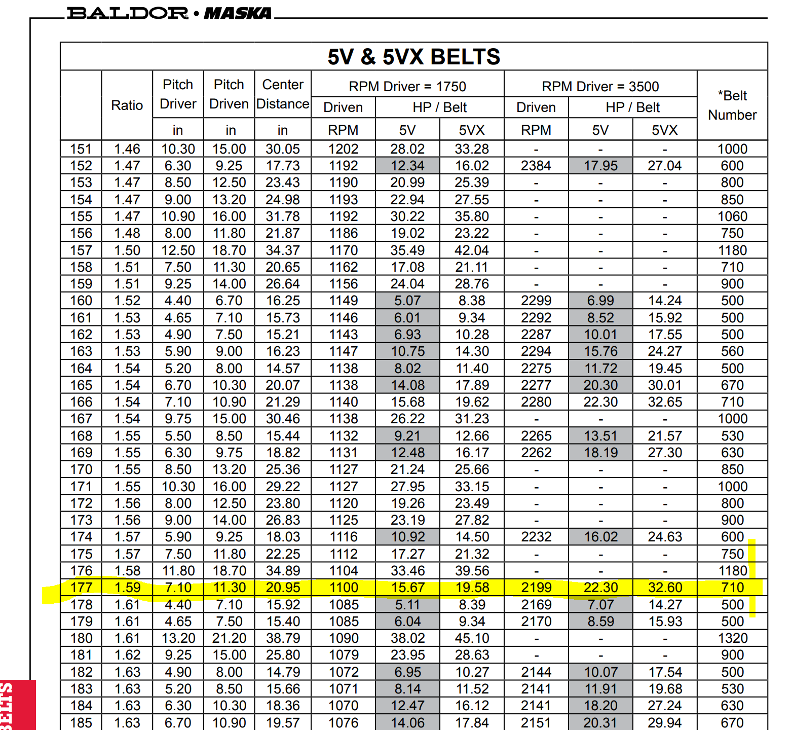
Belt Selection from an industrial manufacturer

Slide 9
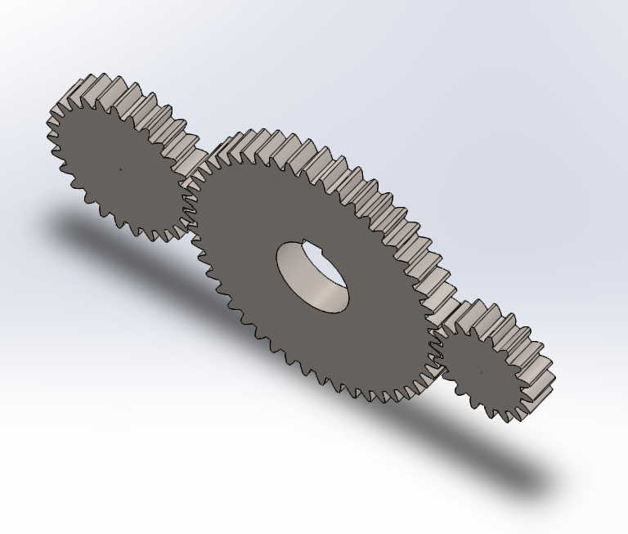
Gear Drive Subsystem
Diameter of pinion (Driving Gear): 3 inches
Number of teeth: 18
Diameter of Idler gear: 8 inches
Number of teeth: 48
Diameter of Driving Gear: 27
Idler gear was used to increase the the center distance
Required RPM to the shaft : 1400 RPM
Theoretical output: 1386 rpm

Slide 10
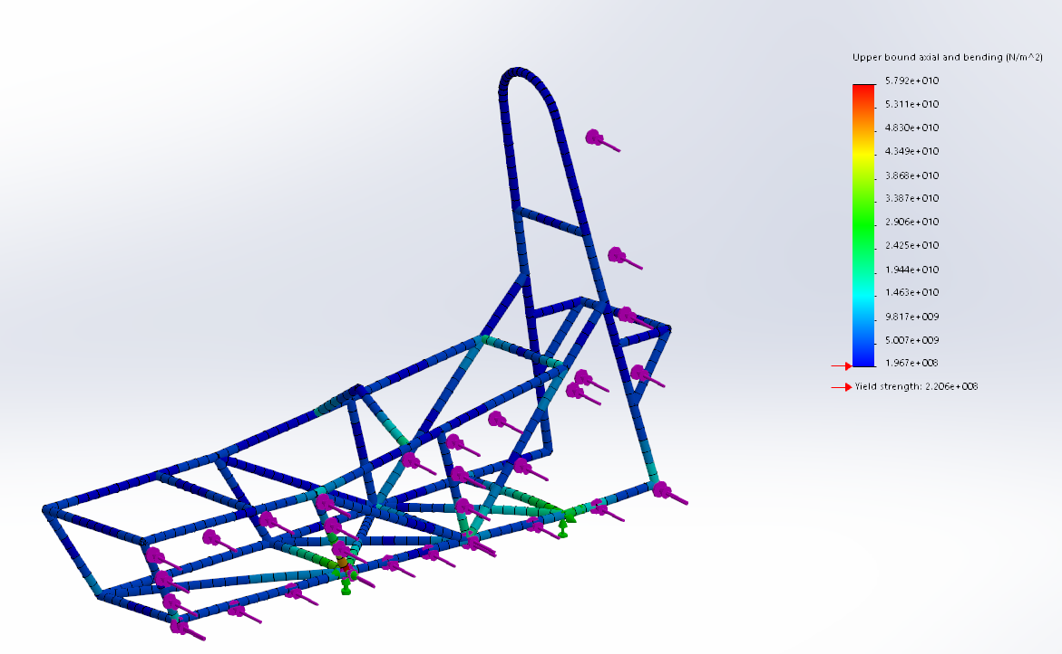
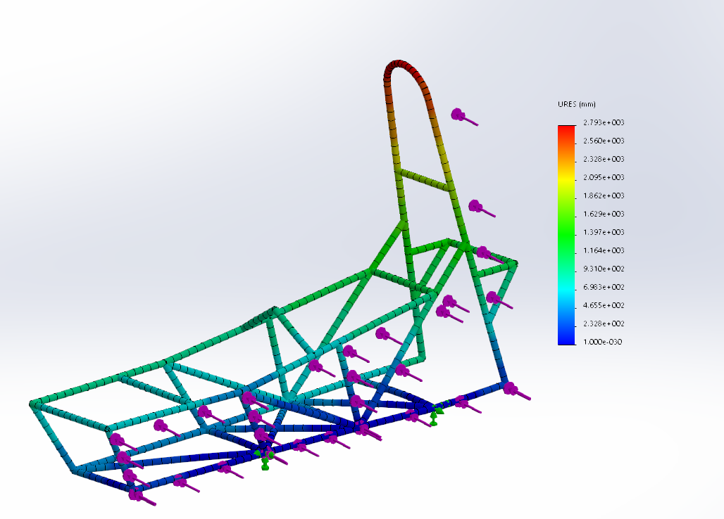
FEA Analysis (In Progress)
Crash Stress Analysis for 100Kg Payload and max speed of 60mph - 144KN Distributed load

Slide 11
Safety
- Inertial Measurement Unit Sensor
-Good Battery Management System
- Aggressive Safety Factors, when designing belt and gears
- Two grounds to isolate high voltage and low voltage components
- Electric vehicle controllers offer more control on motor rotation and speed than internal combustion engine
Cost
Motor - $4500 CAD
Structural Members (1060 Plain Carbon Steel) - $800
Battery (18650s) - $3000
Competitors Price (Electra Mechanical Solo) - $20500

